Slide 1

To make an algorithm which can search through a data as fast as possible
Group Members:
Jenil Sadhwani – RA2211026010425
Mrugan Kulkarni – Ra2211026010433
Aditya Gupta – RA2211026010434

Slide 2

Content:
Ideology
Modules and Module Description
Architecture and Block diagram
Code
Output
Time Complexity
Conclusion and References

Slide 3
Ideology
With the help of splay tree data structure, we would create a tree whose nodes are embedded with the Ip address of the device that are connect to a specific network router. In our code we have taken 11 devices connected to one network router and so there would be some common part in the Ip address of each of the devices. Now, router gets some specific data packets from the net which is supposed to be given to a specified device and so it uses searching operation to find the correct Ip address. To increase the speed of this process we use splay tress for searching and inserting the Ip addresses. It is the fastest data structure for searching operation. Therefore, the router sends the data packet to the specified Ip address when multiple devices are connected. Here we have used the random function to input the data packets so that there is no input function required and the processes is completely automatic as it takes place in network router.
Basic principle: it uses the principle that the most occurring Ip address stays at the top and so the time complexity of searching decreases eventually.
Methodology: to keep the most recurring element on the root node the data structure uses splaying operation

Slide 4
Modules and Module Description
Header and Structure Definitions:
1. Standard C libraries are included which are “stdio.h and stdlib.h”
2. Two structures are defined: node for representing tree nodes and
slay_tree for the tree itself.
Process Module:
1. Functions are defined for creating new nodes and Splay Trees, finding the maximum node, left and right rotations, splaying a node to the root, inserting a new node into the tree, searching for a node and splaying it, and performing an in-order traversal of the tree.

Slide 5
Modules continued..
Implementation Module (main function):
In the main function, a Splay Tree is created.
Nodes with different IP addresses are created and inserted into the tree.
Random data packets are assigned to some nodes in the tree.
The code prints the IP addresses and associated data packets in ascending order of IP addresses.

Slide 6
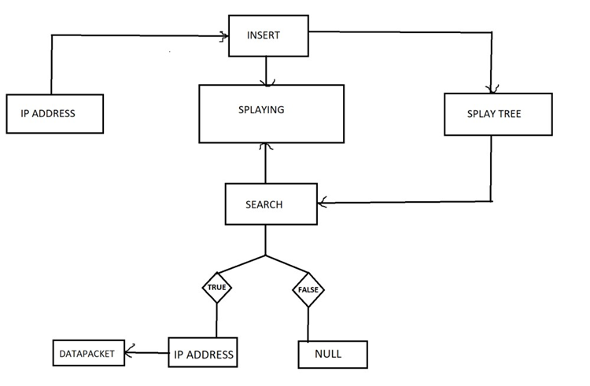
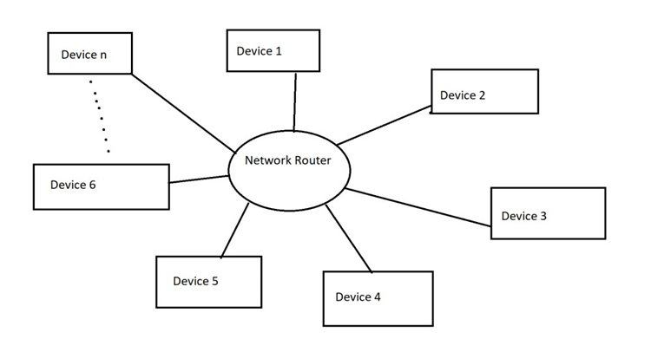
Architecture and Block Diagram

Slide 7
Code: (skip to slide 20 for Output)
Starting Module:
#include <stdio.h>
#include <stdlib.h>
typedef struct node { int ipAdd; int dataPacket; struct node *left; struct node *right; struct node *parent;
}node;
typedef struct splay_tree { struct node *root;
}splay_tree;
This is the starting module which includes the library files needed and the defining of the structures.

Slide 8
Code continues…
Process Module:
node* new_node(int ipAdd) { node *n = malloc(sizeof(node)); n->ipAdd = ipAdd; n->parent = NULL; n->right = NULL; n->left = NULL;
return n;
}
splay_tree* new_splay_tree() { splay_tree *t = malloc(sizeof(splay_tree)); t->root = NULL;
return t;
}

Slide 9
Code continues…
node* maximum(splay_tree *t, node *x) { while(x->right != NULL) x = x->right; return x;
}
void left_rotate(splay_tree *t, node *x) { node *y = x->right; x->right = y->left; if(y->left != NULL) { y->left->parent = x;
}

Slide 10
Code continues…
y->parent = x->parent; if(x->parent == NULL) { t->root = y;
}
else if(x == x->parent->left) { x->parent->left = y;
} else {
x->parent->right = y;
}
y->left = x; x->parent = y;
}

Slide 11
Code continues…
void right_rotate(splay_tree *t, node *x) { node *y = x->left; x->left = y->right; if(y->right != NULL) { y->right->parent = x;
}
y->parent = x->parent; if(x->parent == NULL) { t->root = y;
}

Slide 12
Code continues…
else if(x == x->parent->right) { x->parent->right = y;
} else { x->parent->left = y;
}
y->right = x; x->parent = y;
}
void splay(splay_tree *t, node *n) { while(n->parent != NULL) { if(n->parent == t->root) {

Slide 13
Code continues…
if(n == n->parent->left) { right_rotate(t, n->parent);
} else { left_rotate(t, n->parent);
} } else { node *p = n->parent; node *g = p->parent;
if(n->parent->left == n && p->parent->left == p) { right_rotate(t, g); right_rotate(t, p);
}
else if(n->parent->right == n && p->parent->right == p) { left_rotate(t, g); left_rotate(t, p);

Slide 14
Code continues…
}
else if(n->parent->right == n && p->parent->left == p) { left_rotate(t, p); right_rotate(t, g);
}
else if(n->parent->left == n && p->parent->right == p) { right_rotate(t, p); left_rotate(t, g);
}
}
}
}

Slide 15
Code continues…
void insert(splay_tree *t, node *n) { node *y = NULL; node *temp = t->root; while(temp != NULL) { y = temp; if(n->ipAdd < temp->ipAdd) temp = temp->left; else temp = temp->right;
}
n->parent = y;
if(y == NULL) t->root = n; else if(n->ipAdd < y->ipAdd) y->left = n; else y->right = n;
splay(t, n);
}

Slide 16
Code continues…
node* search(splay_tree *t, node *n, int x) { if(x == n->ipAdd) {
splay(t, n);
return n;
}
else if(x < n->ipAdd) return search(t, n->left, x); else if(x > n->ipAdd) return search(t, n->right, x); else return NULL;
} void inorder(splay_tree *t, node *n,char* cmn) { if(n != NULL) { inorder(t, n->left,cmn);
printf("%s%d -> %d\n",cmn,n->ipAdd,n->dataPacket); inorder(t, n->right,cmn);
}
}
This is the process module which includes all the functions (void, int, node* & splay_tree*) and processing takes place in these functions.

Slide 17
Code continues…
int main() {
char* cmn="192.168.3."; splay_tree *t = new_splay_tree();
node *a, *b, *c, *d, *e, *f, *g, *h, *i, *j, *k, *l, *m; a = new_node(104); b = new_node(112); c = new_node(117); d = new_node(124); e = new_node(121); f = new_node(108);
g = new_node(109); h = new_node(111); i = new_node(122); j = new_node(125); k = new_node(129); insert(t, a); insert(t, b); insert(t, c); insert(t, d); insert(t, e); insert(t, f); insert(t, g); insert(t, h); insert(t, i); insert(t, j); insert(t, k);

Slide 18
Code continues…
int x;
int find[11]={104,112,117,124,121,108,109,111,122,125,129}; int add[11]={a,b,c,d,e,f,g,h,i,j,k};
srand(time(0)); for(x=0;x<11;x++)
{
int data=rand()%200; node* temp=search(t,add[x],find[x]); if(temp!=NULL)
{
temp->dataPacket=data;
}

Slide 19
Code continues…
}
printf("IP ADDRESS -> DATA PACKET\n"); inorder(t, t->root,cmn);
return 0;
}
This is the implementation module of the int main(). This includes calling or implementing of the functions.

Slide 20
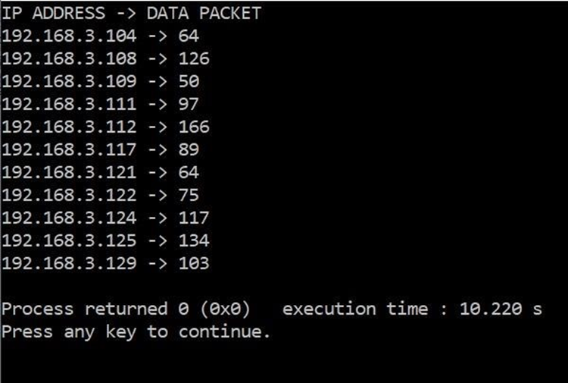
Output

Slide 21
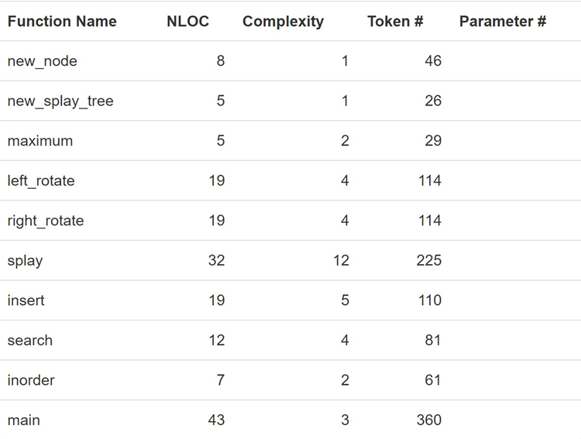
Time Complexity

Slide 22
Conclusion
when multiple devices are connected in one router and millions of data packets are being sent in time of seconds, splay tree is the most convenient data structure to be used in such fields.

